Slide 1
Summerfield Music School
Michael Amoo

Slide 2
Services
Instruction
Instruments
Performance

Slide 3
Instruction
Master Violin Class

Slide 4

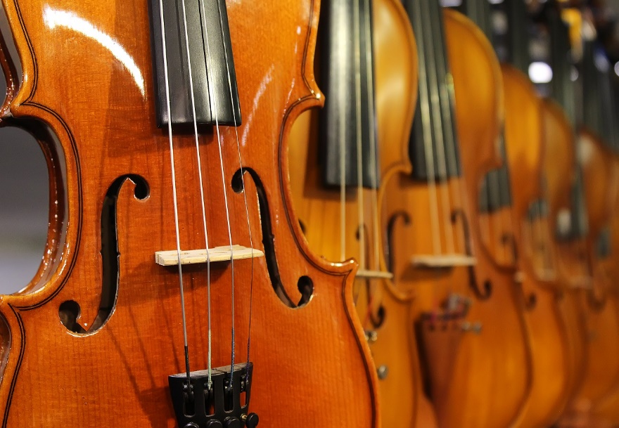

Instruments

Slide 5
Performance
A song
in our hearts…

Slide 6
Questions?
Contact us at:
Exploring2019@Outlook.com

